Slide 1


Title of Presentation
Project Lead:
Quantitative Developers:
Quantitative Analysts:
5/27/26
Oregon Quant Group

Slide 2


Introduction
~1.5 min
What is the core research question, and why does it matter right now?
Give the audience enough macro/market context to care.
State the strategy area (e.g. equities, global macro, alt data)
Name the data source or signal type you are exploring.

Slide 3

Introduction
Use various methods of predictive modeling to generate alpha through analysis of fixed income markets
Goal
Data
FRED (macroeconomic data)
The AGG, the gold standard for measuring the U.S. fixed income market
Process
Machine learning (ElasticNet regression) to predict volatility
Use predicted volatility as investment signal (Buy/hold or sell)
Optimized model hyperparameters (L1 & L2)
5-Fold Cross Validation
RMSE optimized Final Signal deduced from strategy returns vs basic market returns
Optimization

Slide 4
Data & Signals
~1.5 min
What data are you using and where does it come from?
Name sources (EDGAR, Yahoo Finance, FRED, etc.), time period, and unit of observation
Describe the signal(s): what are you measuring, how is it constructed, and what is the intuition for what it should predict returns?

Slide 5

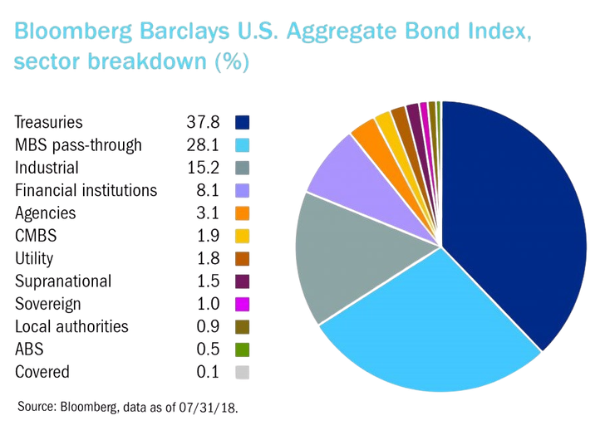
Data & Signals
FRED (Economic data)
Macro Economic Predictors: Interest rate, Inflation rate, Unemployment, Economic Output, Market Liquidity, Commodities pricing.
Bloomberg Aggregate Index (AGG)
Gold Standard for assessing the US Fixed Income market
Tracks roughly half the overall bond Market (~28 Trillion estimated asset value today)
Index is diversified across the various types of assets in the U.S. fixed income market

Slide 6
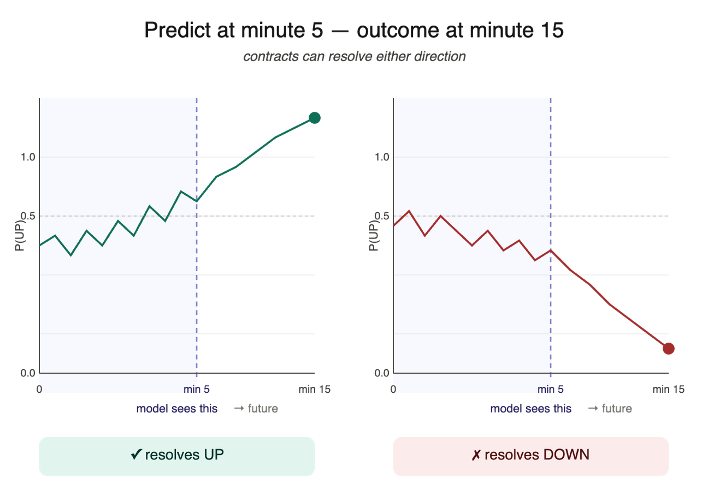
Identifying Signals in the First 5 Minutes
~52.5% of contracts resolve UP
Test on first 5 minutes, predict last minute prob
Goal: tell similar-looking early windows apart

Slide 7
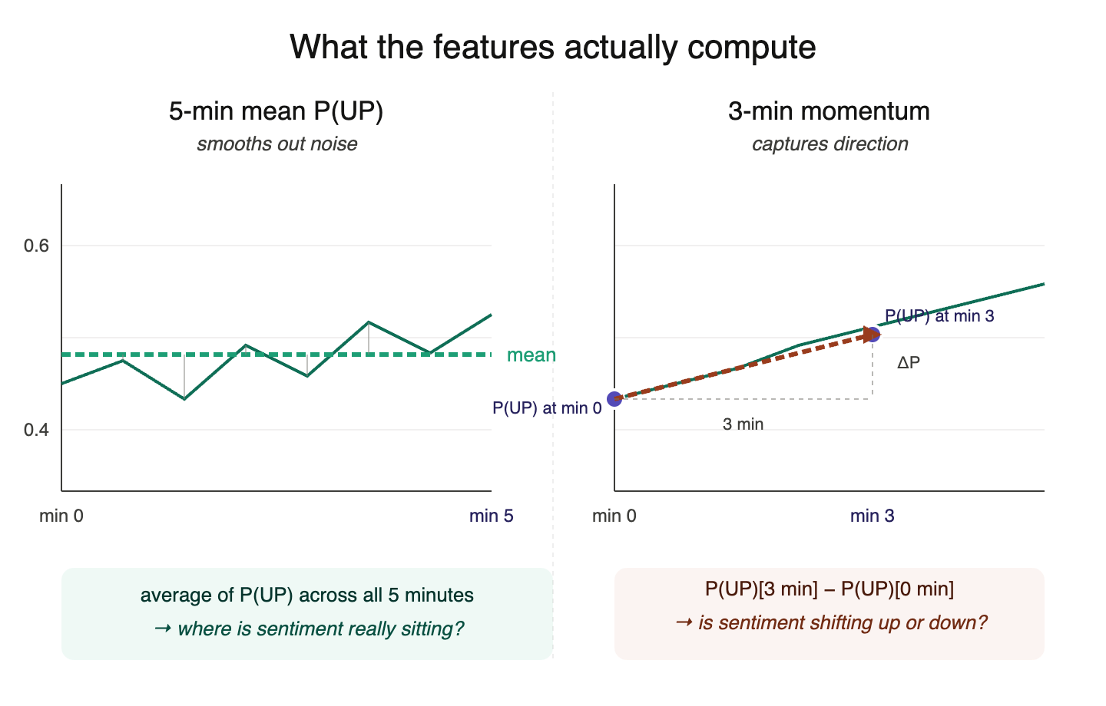
Feature Engineering Mean and Momentum
Mean smooths through noisy thin liquidity
Momentum captures direction the mean can't
Together: level + trajectory of sentiment

Slide 8
Methodology
~1.5 min
Walk through the analytical approach at a high level
What type of model or framework are you using (e.g. machine learning, event study, regression)
Whyt this approach over alternatives?
Describe the pipeline: feature engineering, training/validation split, any backtesting or walk-forward structure.
A simple flowchart or diagram works well here
Avoid heavy jargon

Slide 9
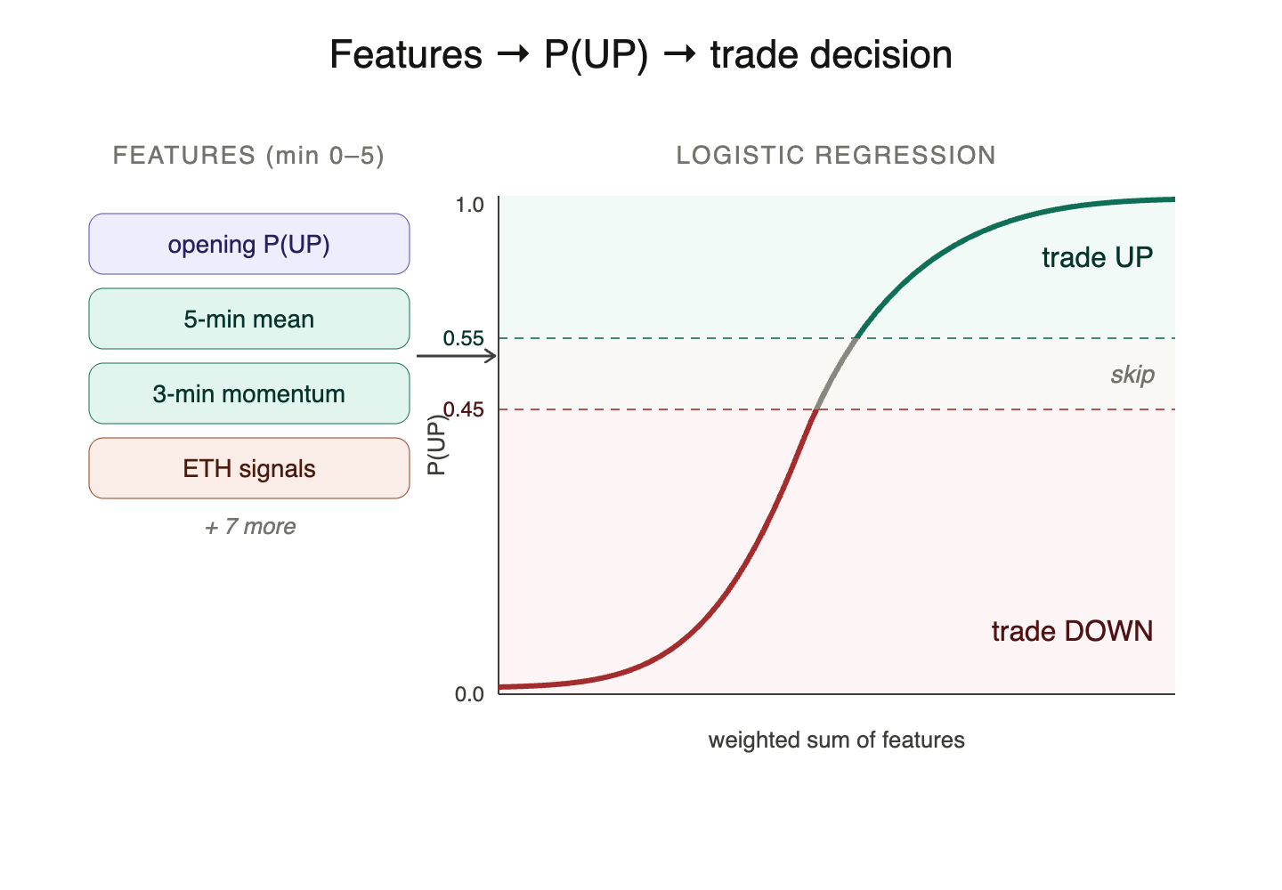
Test the Signals with Logistic Regression

Slide 10
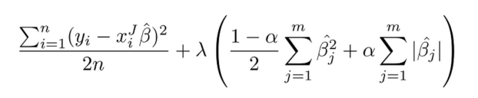
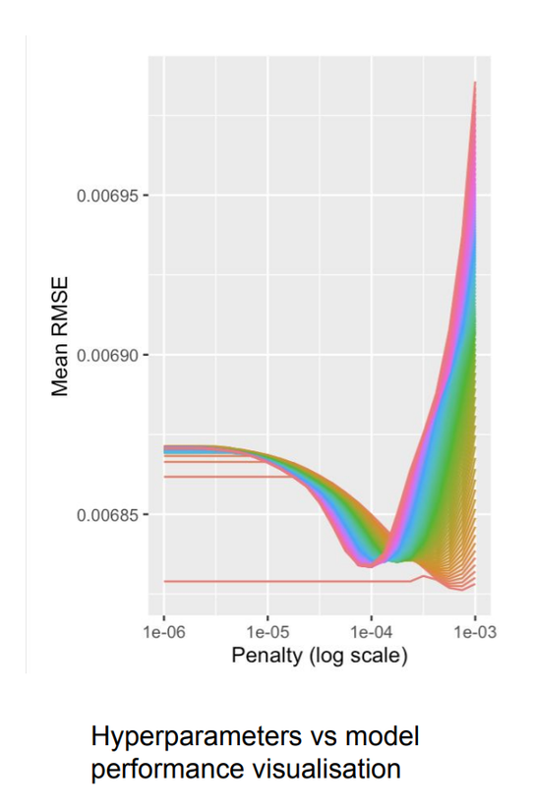
Methodology
ElasticNet Regularization:
Volatility Prediction
Model Predicts volatility for the AGG using time-series data and training data from FRED
Uses ElasticNet Regularization to optimize volatility projections
Investment Strategy
Select a volatility threshold from predicted values
Signal investment if predicted value for that period is above threshold

Slide 11
Methodology
ElasticNet Regularization:
Volatility Prediction
Model Predicts volatility for the AGG using time-series data and training data from FRED
Uses ElasticNet Regularization to optimize volatility projections
Investment Strategy
Select a volatility threshold from predicted values
Signal investment if predicted value for that period is above threshold

Slide 12
Results
~2 min
Show your most key finding
Include at least two charts or tables with titles, labelled axes, and a one sentence caption explaining the key takeaway
Anchor every claim to a specific number: not “the signal performed well” but “annualized Sharpe of 1.3 vs. 0.6 for the benchmark.”
If your results are preliminary or mixed, say so clearly

Slide 13
Strategy & Position Logic
~1 min
Translate the signal into actual trades
When do you enter? When do you exit? How are positions sized?
What is the rebalancing frequency?
If you have a regime filter or resk overlay, describe it in plain language
The goal is for the audience to understand what a live version of this strategy would actually do on a given day

Slide 14
Backtesting & Evaluation
~1.5 min
Report performance metrics: annualized return, Sharpe ratio, max drawdown, hit rate
Compare against a relevant benchmark
If you ran out-of-sample or walk-forward tests, show how in-sample vs. out-of-sample results compare.
Flag any look-ahead bias or data leakage risks you identified
Mention transaction cost assumptions
Be direct about where the model underperformmed and why

Slide 15
Limitations & Next Steps
~1 min
What are the biggest constraints on this analysis?
Think data availability, sample period, model assumptions, overfitting risk, execution feasibility
What would you do differently with more time or resources? Name one or two concrete steps

Slide 16
Q&A
Add citations, names, and emails here

